Slide 1
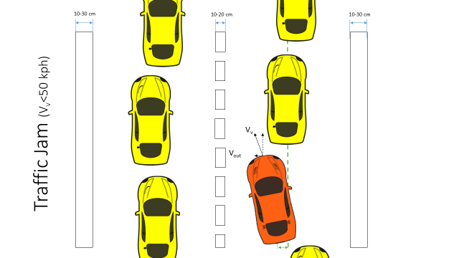
Active Lane Centering
Status Update
A nshuman Singh
D avide Occello
R A ymond Wouters
S harad Bhadgaonkar, February 09th 2017

Slide 2
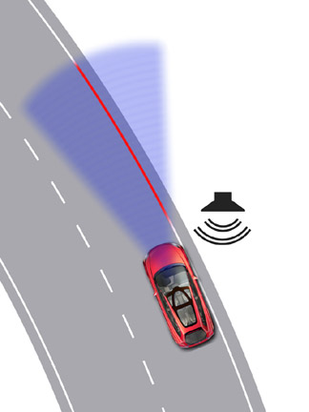
Agenda
Status from the last lesson
Project planning
Work done so far
Future work

Slide 3
Status at the end of second phase
Delivery: High level design document
  Use of CAFCR framework for system architecting
  Analysis of existing Hardware
    Study hardware components
    Study communication networks
  Hardware architecture proposals
Safety concept updated

Slide 4
Project Timeline
Phase 1: Functional Safety
Phase 2:
Design
23 days
Phase 3: Implementation
25/11/16 – 13/01/17
26 days
12 days
43 days
55 days
1st Presentation to NXP
Status meeting:NXP
Status meeting
Meeting
with Arash
06.01.17
2016
Nov
Dec
Holidays
Jan
2017
Today
Feb
Mar
20.01.17
25.11.16
13.01.17
16.01.17
27.01.17
30.01.17
28.03.17
Project Kick Off
Project End

Slide 5
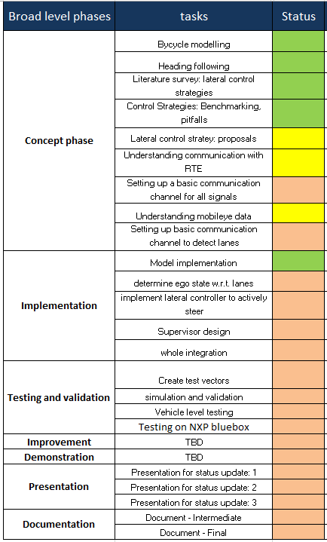
Project Timeline
Today

Slide 6
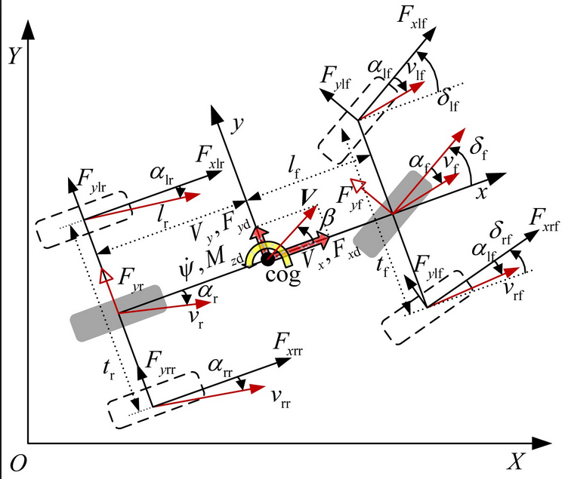
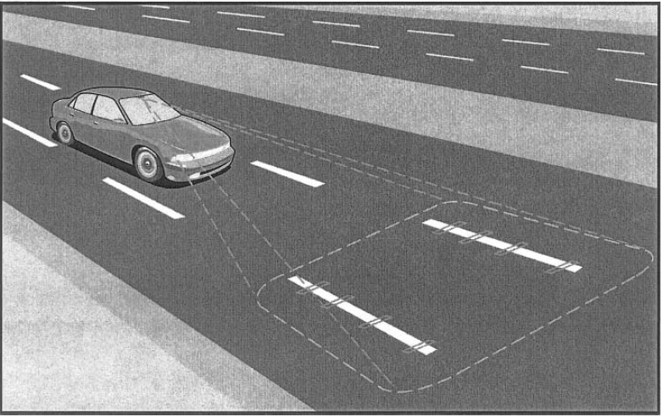
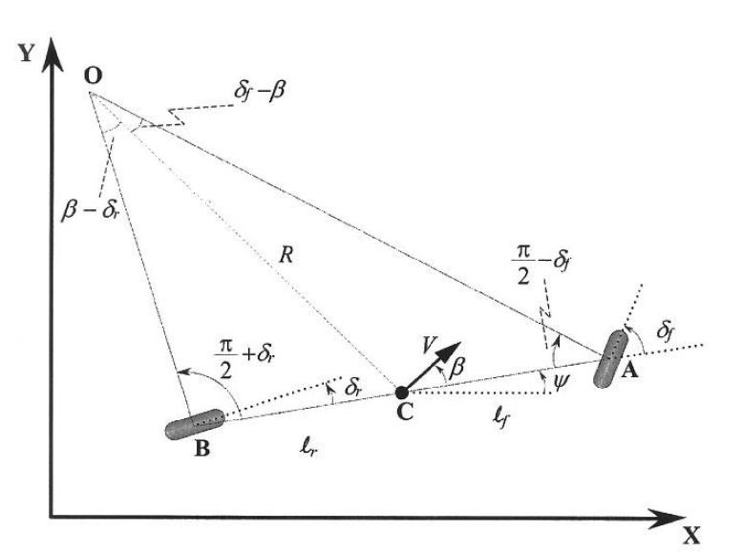


Work done so far : Vehicle modelling
Bicycle modelling

Slide 7
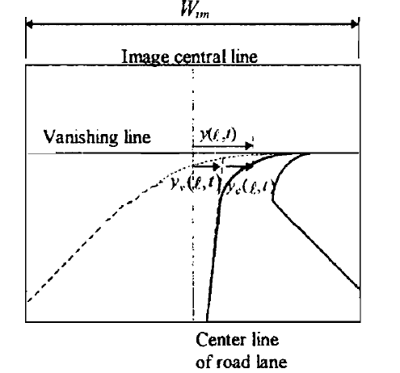
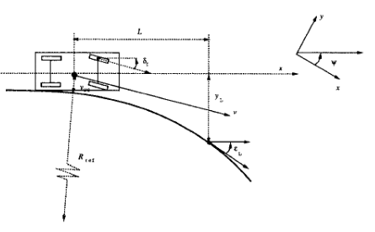

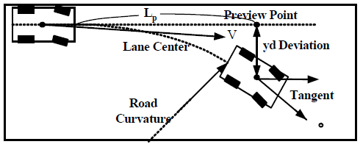
Work done so far: Vehicle modelling
Road modelling/ Vision sensing of road
Desired path

Slide 8
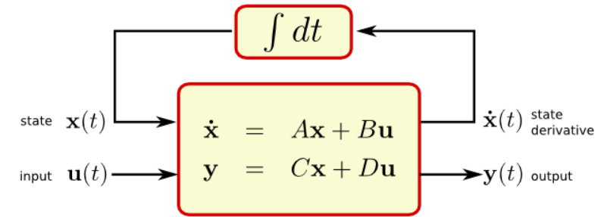
Work done so far: Vehicle modelling
Modelling and simulation in Matlab
State space representation
Modelling of combined bicycle and road model
Simulation and verification

Slide 9
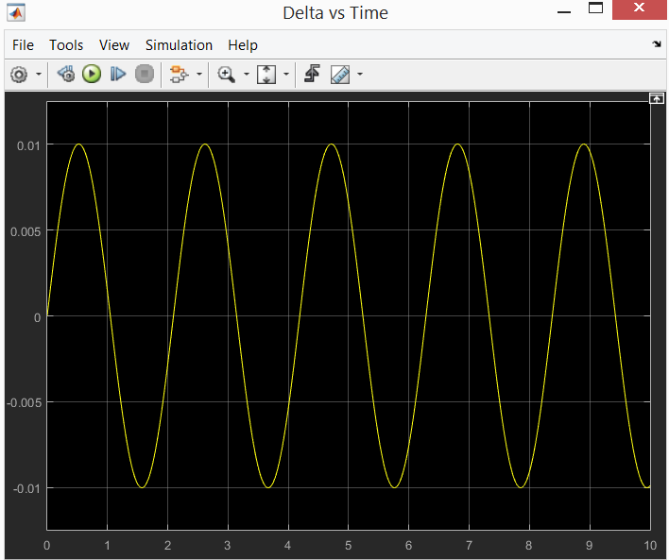
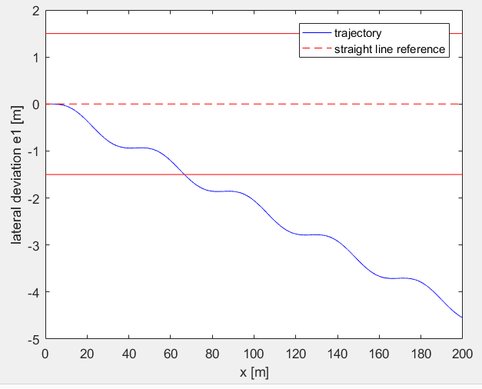
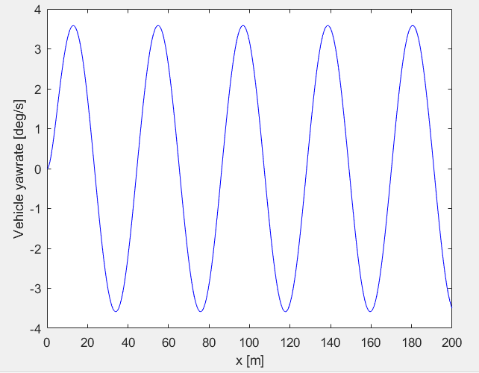
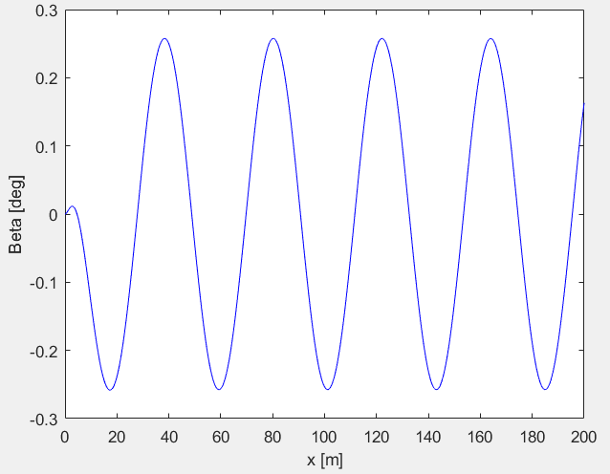
Work done so far: Vehicle modelling
Matlab plots: verifying the Bicycle model
Inputs: Sinusoidal steering angle
of 0.01 rad with 3 rad/s
Road Curvature = 0

Slide 10

Control Strategies
Controller |  | Simplicity (Implementation) | Computational Efficiency | Performance (Tracking) | Robustness
PID |  | ++ | ++ | - | -
Adaptive PID | Fuzzy Logic | -- | - | + | +
 | Neural Network | -- | -- | ++ | +
 | Minimum Variance | + | + | + | +
 | Nested | + | + | + | +
LQR |  | + | + | + | +
Robust Control |  | - | - | + | ++
H2 Optimal |  | - | - | + | +
Sliding Mode |  | -- | - | + | ++
MPC |  | -- | - | ++ | ++
Cost
Quality
Notes:
Way too short

Slide 11
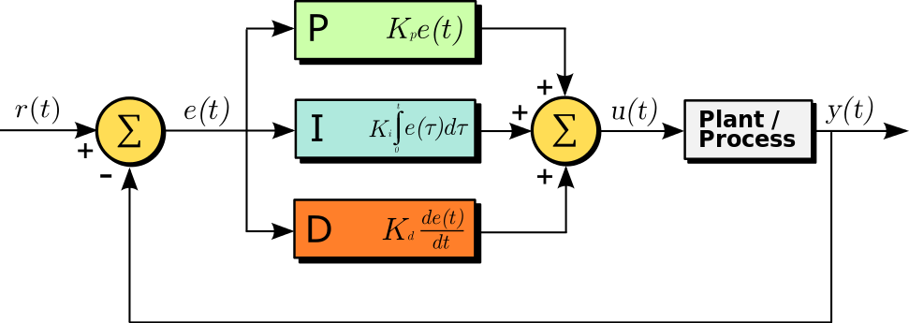
Control System
Controller
Vehicle Model
Coefficient
Adapter

Slide 12
Planning for Phase 3
Short term goals ( next 2 weeks)
Analyzing real time prototyping environment and setting up communication
Determining and implanting of ego state w.r.t lanes
Understanding mobile data and creating switch for replaceable interface
Implementation of lateral control strategy
Long term goals
Develop lateral control strategy for ALC
Design and implement ALC software in car
Testing and validation with basic test cases
Update System Design Document
Presentation and demonstration
Running low level control algorithm on BlueBox
Implementation for switching between MobilEye
and HDR Mono camera

Slide 13
Questions
?

Slide 14
Planning for Phase 3 : to be deleted??
Phase 3:
Implementation
43 days
26 days
Vehicle Model
Literature Review
Improvement
Controller Design
Testing
Comunication Setup
Demonstration & Presentation
28th March
Simulation phase
Predicted Arrival of Speedgoat
15nd Feb
Prototype phase
Finalization phase
Documentation Delivery
28th March
2016
Jan
Today
Feb
March
2017
30.01.17
28.03.17
Project End
Start Phase 3

